Slide 1

Computational Social Science Analytics Project
Hong Kong 2019
(Insights from Hong Kong Protests)
IS434 Group 18
Team:
Bu Wende
Jiang Hanyu
Qi Haodi
Zhang Chengzi

Slide 2
Contents
1
Business Problem
2
Description of Data
3
Analysis Method
4
Insights and Findings
5
HK Protests Timeline

Slide 3
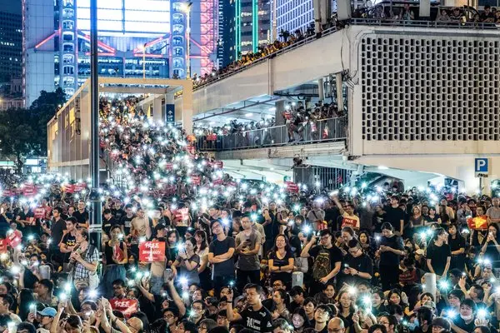
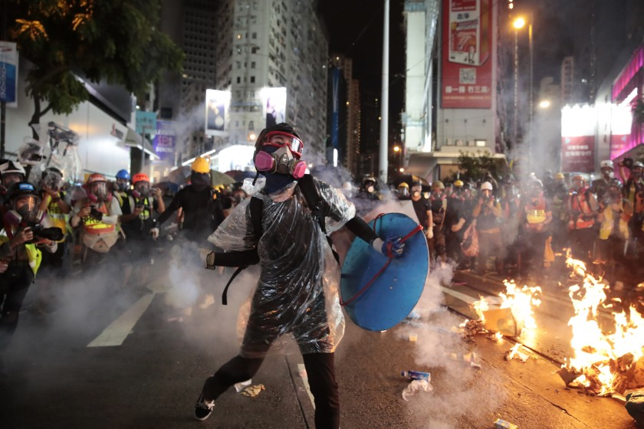
The 2019 Hong Kong Protests Explained
In March, the 2019 Hong Kong Protests sparked off by the Extradition Law Amendment Bill;
The bill allowed for criminal suspects to be extradited to mainland China under certain circumstances;
Hundreds of thousands of Hong Konger took to the street to protest until now;
Tension between police and protesters has escalated;
People express their opinions through social media platforms.

Slide 4
Our Clients and business problem
News and Media Agent & Journalists
Lack of method to capture, analyse and report the public sentiments online as a whole.
Academic Researchers
(Sociology & Politics)
Difficult to trace community network involved on the research topic and identify key stakeholders;
Lack of statistical and scientific evidence to testify to a hypothesis.

Slide 5


Data Sources and Description
Twitter
Use Twitter API;
Data includes user data, tweet contents, hashtags, geographical data etc.
Collected on a daily basis.
Reddit
Use Reddit API;
Data includes user data, number of likes, submission contents, comments and replies under the Sub-Reddit category of Hong Kong .
Youtube
Use Youtube API with web scraping libraries;
Data includes viewers’ comments and replies, and video descriptions for the most popular videos.

Slide 6
Analysis Methods and Tools
APIs & Selenium
Data Sourcing and Web Scraping Libraries
NLTK & Textblob
Text analysis python libraries to analyse tweet content, comments and replies
Sentiment Analysis
Social Network Analysis
Networkx
Clustering Analysis
To calculate various measures about nodes and the entire network to identify key stakeholders
Gephi & Tableau
Third-party tools used to visualize twitter networks and findings

Slide 7
Analysis & Insights
Sentiment Analysis
Network Analysis
Clustering Analysis
Public Opinions
Key Stakeholders
Categorisation
General sentiment of the user population;
Changes in sentiment over time with key incidents;
How different cultural background will affect their sentiments and perspectives on HK issues
Identify key stakeholders in the social networks based on different centrality measures;
Identify communities of users on different platforms, especially twitter and their common opinions;
Analyse the network structure and characteristics
Text clustering using cosine similarities to categorize tweets, Reddit submissions and Youtube video descriptions;
Time series word cloud.

Slide 8
Hong Kong Protest Timeline
Key events in the past five months
June 6
First clash
June 12
First use of tear gas by police
July 1 (HKSAR Establishment Day)
Protesters broke in the Legislative Council
Aug 13
Protesters tied up and beat two men from mainland China at airport
Sep 4
Carrie Lam announced formal withdrawal of the extradition bill
June
Oct 1 (National Day of PRC)
Protester shot by police with real bullet for the first time
July
June 9
First major march against extradition bill
August
July 9
Carrie Lam announced the extradition bill is dead
September
Aug 11
Woman shot by police in the eye
Aug 26
Police fired live warning shot into the air for first time
October
Oct 5
Anti-mask law took effects

Slide 9
Thank you!

